Slide 1





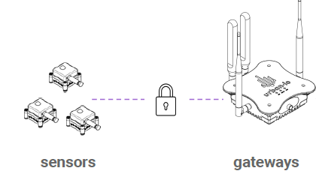






On Prem Facility
AWS Cloud
Customer AWS Account
Urban.io AWS Account
AWS IoT SiteWise
Urban.io IoT SaaS Platform
AWS IoT Core
AWS Lambda
Amazon SQS
AWS Lambda
Amazon S3
Amazon
DynamoDB

Slide 2






On Prem Facility
AWS Cloud
Urban.io AWS Account
Customer AWS Account
Lifecycle events to cache
Amazon
DynamoDB
Urban.io IoT SaaS Platform
4
1
Integrations model
Asset
model
Setup SiteWise Integration
Web App
3
5
Amazon S3
Lifecycle events Converter
Asset
Events model
2
6
Assets FIFO
7
8
Data API & MQTT Bridge
Lifecycle FIFO
Asset Model Converter
Association Updater
AWS IoT Core
10
11
AWS IoT SiteWise
Property Values FIFO
Lifecycle Events
Lifecycle events
IoT Core to FIFO sender
12
Device Measurements
Device measurements
Rule Action
13
9
Attributes Updater
AWS IoT SiteWise Monitor

Slide 3
AWS Cloud
Customer AWS Account
Lifecycle events to cache
Amazon
DynamoDB
2
Integrations model
6
Asset
model
3
4
1
Lifecycle events Converter
Asset
Events model
Amazon S3
5
7
10
Assets FIFO
8
9
11
Lifecycle FIFO
Asset Model Converter
Association Updater
AWS IoT Core
AWS IoT SiteWise
12
13
14
15
Property Values FIFO
Lifecycle Events
Lifecycle events
IoT Core to FIFO sender
16
17
Device Measurements
Device measurements
Rule Action
18
Attributes Updater
AWS IoT SiteWise Monitor

